Slide 1
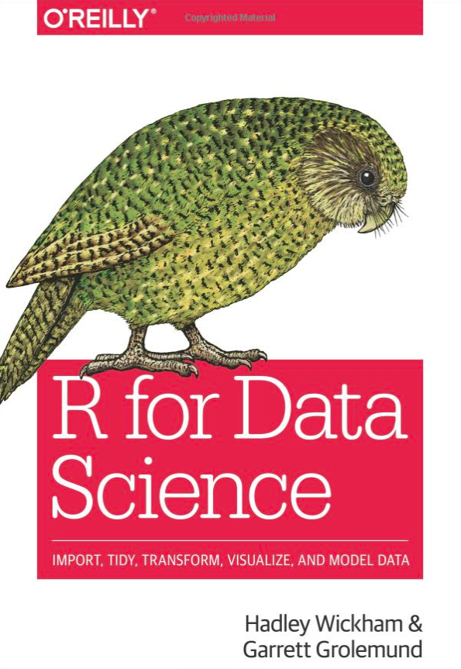
Get your raffle ticket now!
Win a signed copy of
R for Data Science
Signed by Hadley Wickham & Garrett Grolemund
Best selling book
Ticket Price:
$1 for a single ticket
$5 for 10 tickets (value deal)

